Slide 1
Creating a low power consumption
Print Server
Sub-titled:
An update on Raspberry Pi’s
and
What is AArch64, A64, arm64, ARMv8-A, Cortex-A53 & A72?
Waikato Linux Users Group
Ian Stewart
2019-xx-xx

Slide 2
Print Server - Considerations
Raspberry Pi / ARM chip has low power consumption
R-Pi with 64 bit instruction set. AArch64 or A64.
Linux OS compiled for A64. Ubuntu Server 18.04.3
Print Server utilities.
Common Unix Printing System (CUPS)
Special Drivers
Remote Management
Multi-core CPUs
4 x USB Ports for printers
Headless
Private LAN

Slide 3
Raspberry Pi’s - Multi-core 64/32 bit ARMv8-A
Rpi Version | Model | Broadcom | Cores | Clock
2 | B V1.2 | BCM2837 | 4 x Cortex A53 | 900MHz
3 | B | BCM2837 | 4 x Cortex A53 | 1.2GHz
3 | B+ | BCM2837-B0 | 4 x Cortex A53 | 1.4GHz
4 | B | BCM2711 | 4 x Cortex-A72 | 1.5GHz

Slide 4
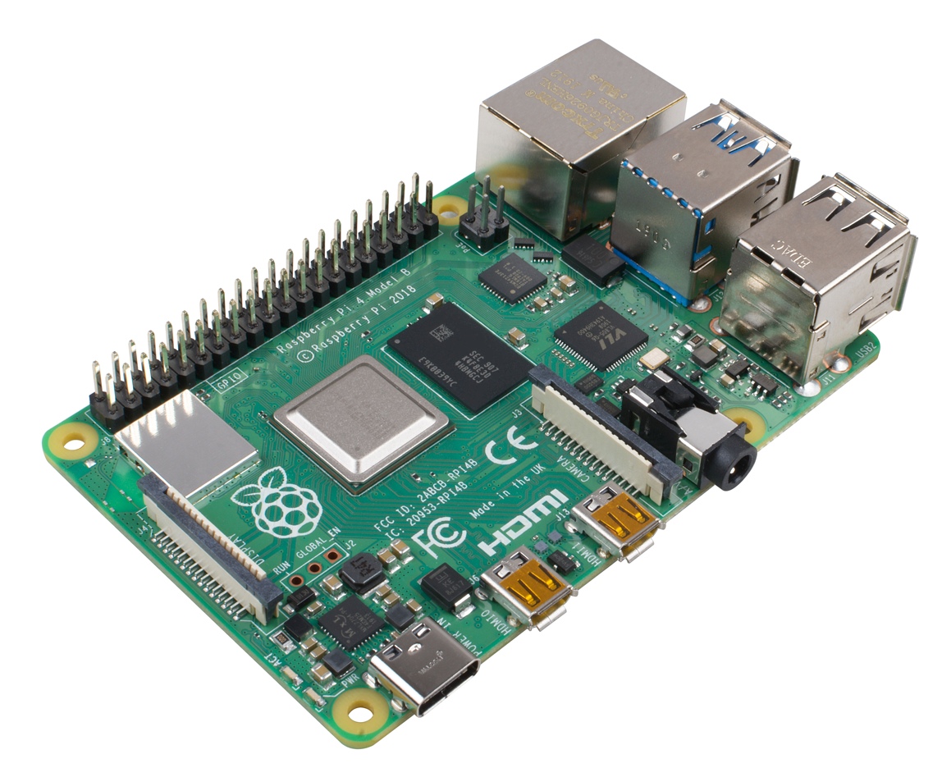
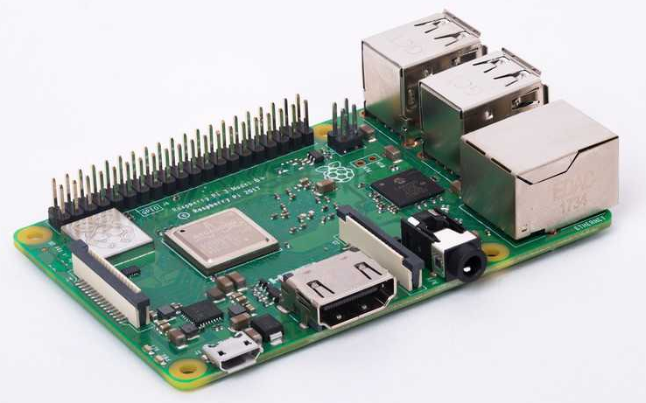
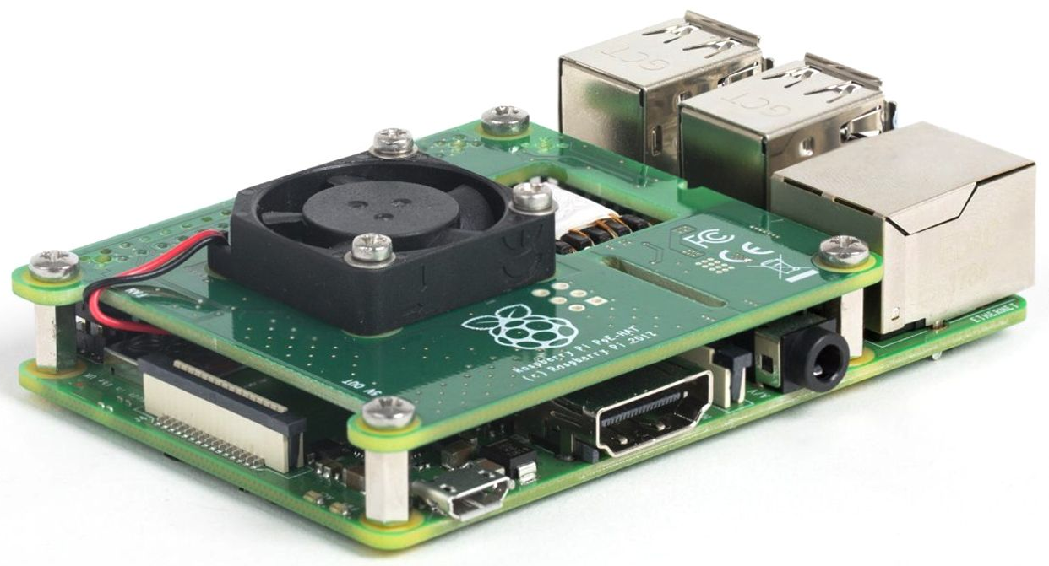
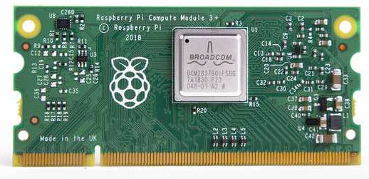
Raspberry Pi’s AArch64 - AMDv8-A
R-Pi 3B+
R-Pi 4B
Pi Compute Module - 3+
Hi-Hat for POE

Slide 5
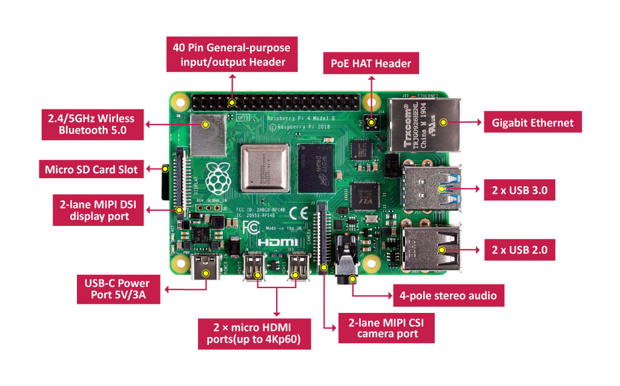
R-Pi 4B Overview – New Features
BCM2711
4 x Cortex-A72
1.5GHz
Separate Memory Chips:
1GB, 2GB, 4GB

Slide 6
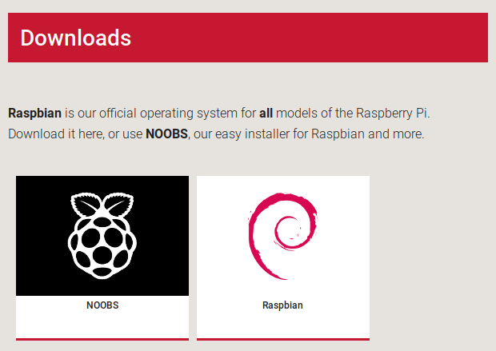

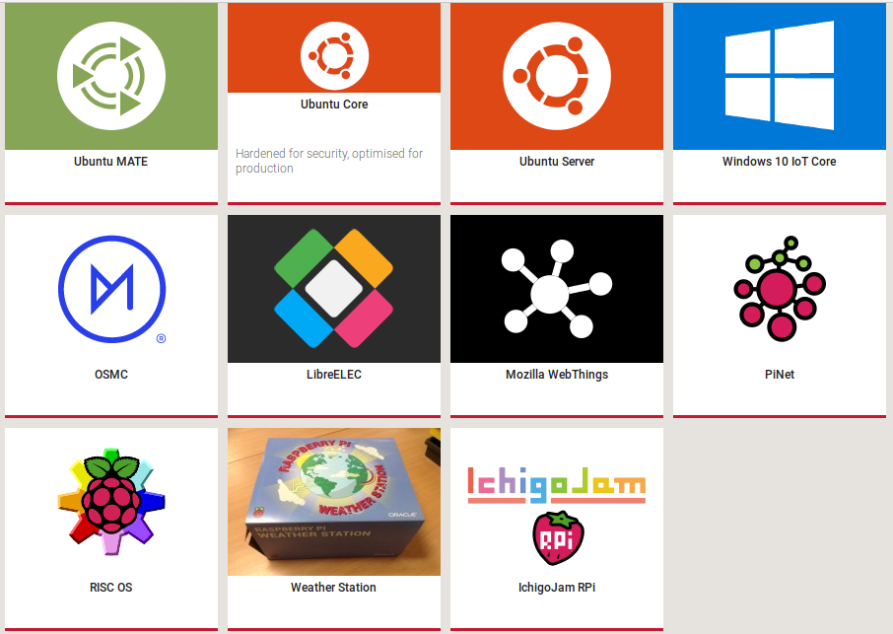
Raspberry Pi – Operating Systems
https://www.raspberrypi.org/downloads/
18.04.2 armhf 32 bit or
arm64 beta
18.?? armhf
18.04.3 arm64
Debian 10 – Buster armhf – 32 bit

Slide 7
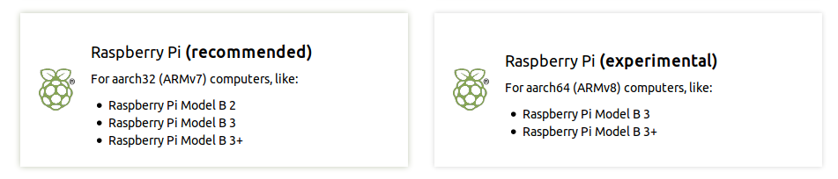


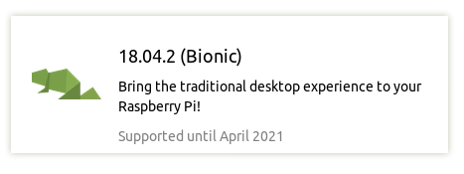


Ubuntu Mate – Download options
beta1

Slide 8
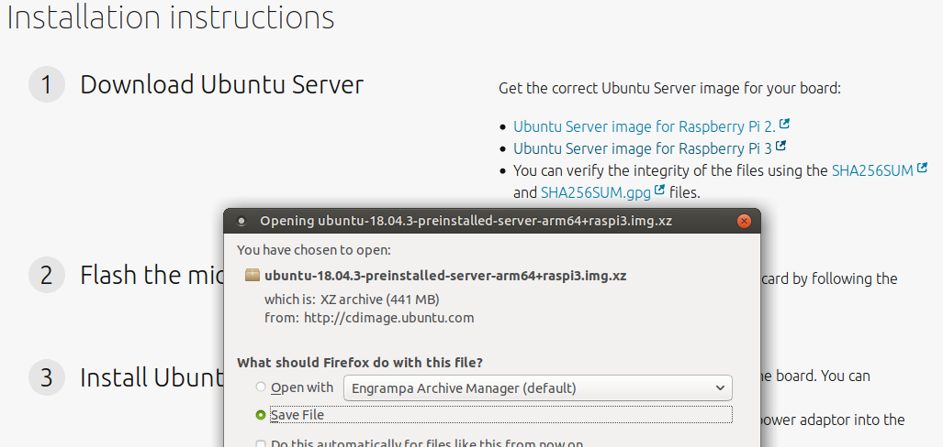
Download Ubuntu Server 18.04.3 arm64
ARM64 for R-Pi 3

Slide 9
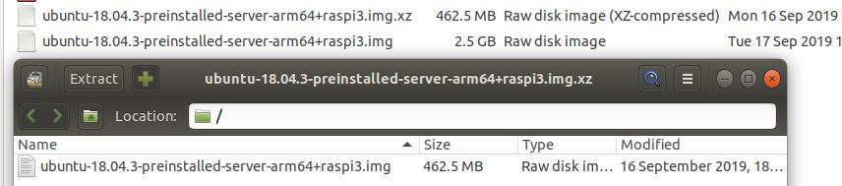
Archive Manager - extracts the .img file
Install to SD-Card using dd...
$ sudo dd bs=32M if=ubuntu-18.04.3-preinstalled-server-arm64+raspi3.img of=/dev/sdb status=progress conv=fsync
75+1 records in
75+1 records out
2521340928 bytes (2.5 GB, 2.3 GiB) copied, 298.925 s, 8.4 MB/s

Slide 10
Boot R-Pi – Start Tailoring
Insert SD-Card into R-Pi
Boot R-Pi
Login to ubuntu account, password: ubuntu
Forced to change password.
Plug into ethernet and get dhcp server address.
$ sudo apt update
$ sudo apt dist-upgrade # <-- 58 Packages
$ reboot
Optional: Implement networking policy.
Change Hostname.
Modem providing fixed IP.

Slide 11
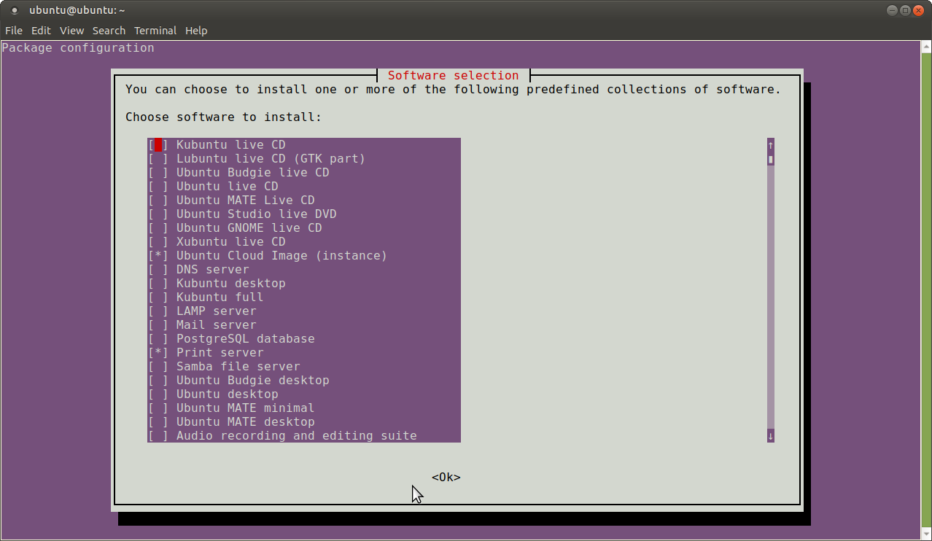
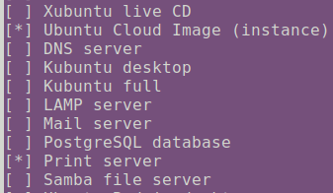
Create print-server
$ sudo apt install tasksel
$ sudo tasksel
From Tasksel Menu, note “Cloud Image” installed.
Select installation of “Print Server” applications (122 files).

Slide 12
Create print-server
Does the printer need special drivers?
$ apt-cache search printer-driver
Returns:
all, brlaser, c2050, c2esp, cjet, cups, dymo, escpr, foo2zjs, foo2zjs, fujixerox, gutenprint, hpcups, hpijs, indexbraille, locale, m2300w, min12xxw, oki, OpenPrinting, pnm2ppa, postscript, ptouch, pxljr, sag, splix
Example:
$ sudo apt install printer-driver-brlaser

Slide 13
SSH into “ubuntu” account on print server
$ ssh ubuntu@10.1.1.9
ubuntu@10.1.1.9's password:
Welcome to Ubuntu 18.04.3 LTS (GNU/Linux 4.15.0-1041-raspi2 aarch64)
* Documentation: https://help.ubuntu.com
* Management: https://landscape.canonical.com
* Support: https://ubuntu.com/advantage
System information as of Tue Sep 17 00:47:59 UTC 2019
System load: 2.5 Processes: 133
Usage of /: 5.5% of 28.21GB Users logged in: 1
Memory usage: 27% IP address for eth0: 10.1.1.9
Swap usage: 0%
In this case the print-server was dhcp served 10.1.1.9
2018 Q1
ARM Architecture
64
amd64
ARMv8-A
DHCP served IP address

Slide 14
Set CUPS for remote administration
ubuntu@ubuntu:~$ sudo cupsctl --remote-admin --remote-any –share-printers
Add “ubuntu” account to the lpadmin group
ubuntu@ubuntu:~$ sudo usermod -a -G lpadmin ubuntu

Slide 15
Check CUPS status
ubuntu@ubuntu:~$ sudo service cups restart
ubuntu@ubuntu:~$ sudo service cups status
● cups.service - CUPS Scheduler
Loaded: loaded (/lib/systemd/system/cups.service; enabled; vendor preset: enabled)
Active: active (running) since Tue 2019-09-17 01:20:34 UTC; 2s ago
Docs: man:cupsd(8)
Main PID: 6530 (cupsd)
Tasks: 3 (limit: 1056)
CGroup: /system.slice/cups.service
├─6530 /usr/sbin/cupsd -l
└─6533 /usr/lib/cups/notifier/dbus dbus://
Sep 17 01:19:21 ubuntu systemd[1]: Started CUPS Scheduler.

Slide 16
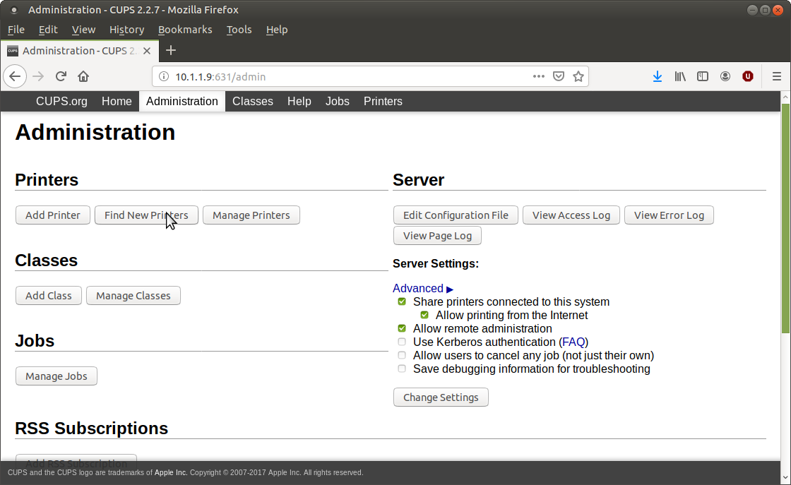
CUPS Remote Administration
10.1.1.9:631

Slide 17
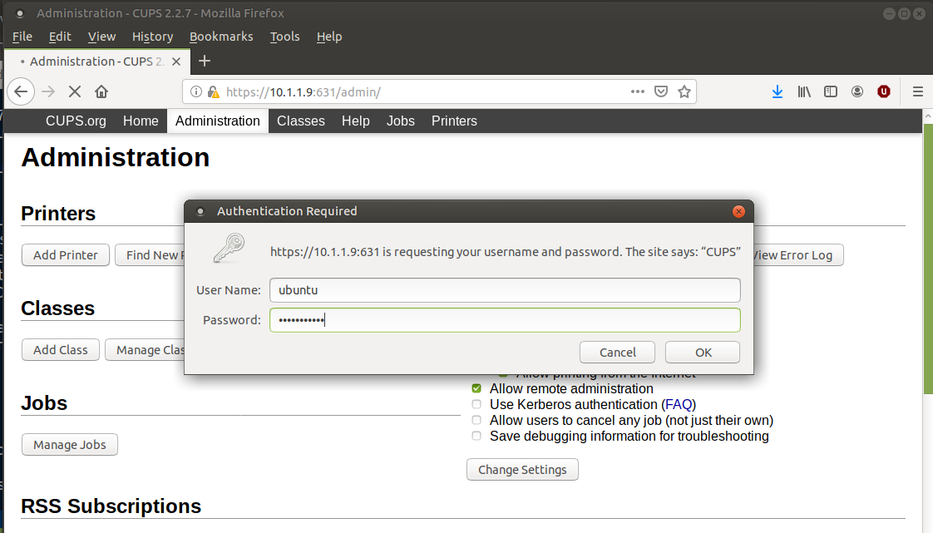
CUPS - Authorisation

Slide 18
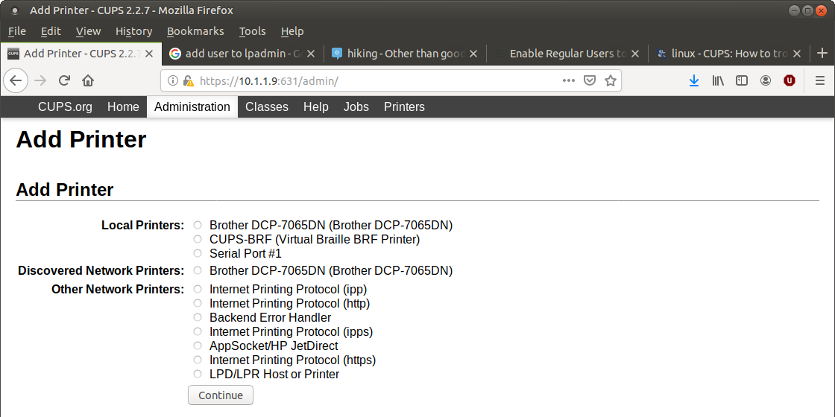
CUPS – Add Printer
Via USB port on R-Pi
Via Ethernet connection to LAN

Slide 19
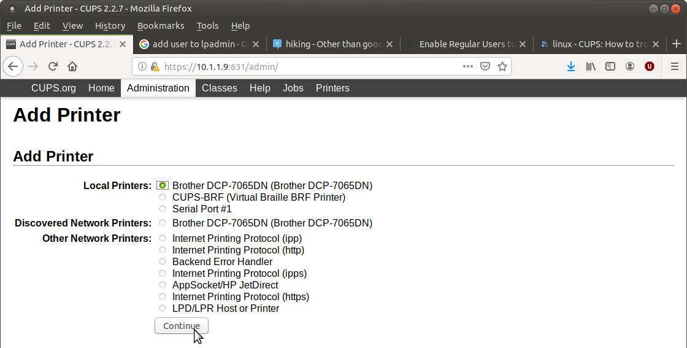
CUPS – Select USB connection to Printer

Slide 20
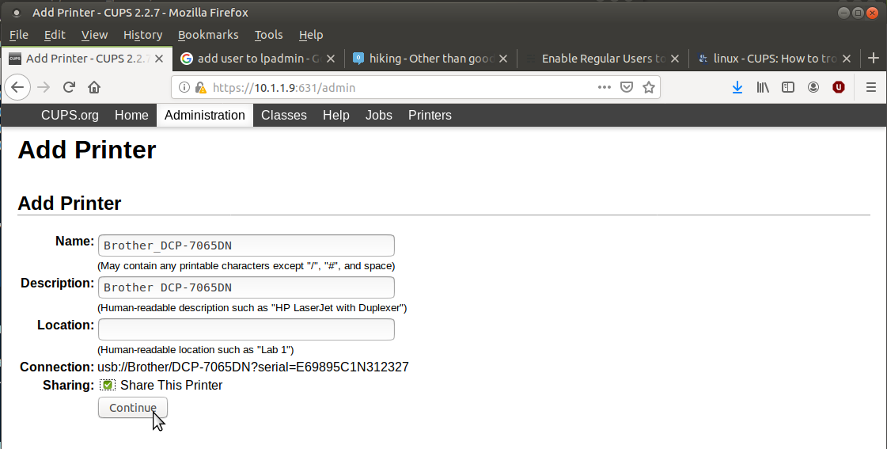
CUPS – Add Shared Printer

Slide 21
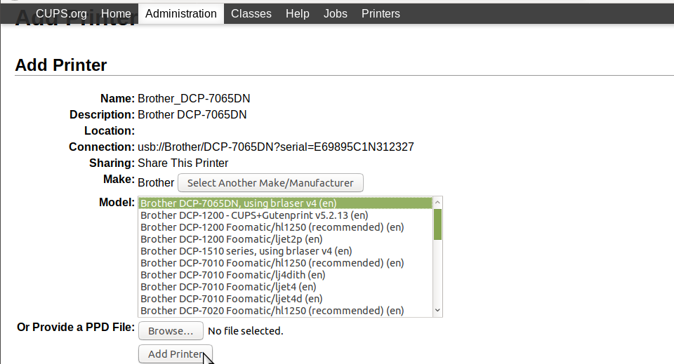
CUPS – Using brlaser driver

Slide 22
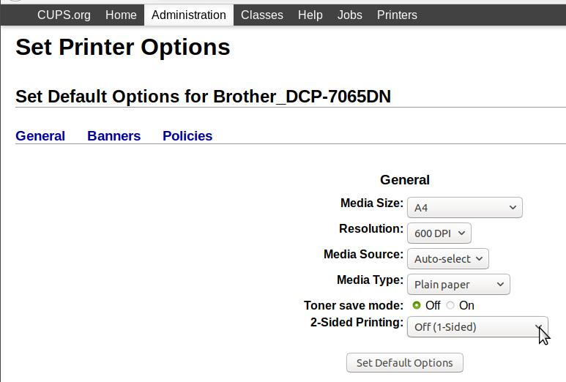

CUPS – Changing Printer Setup
Changed to Duplex printing

Slide 23
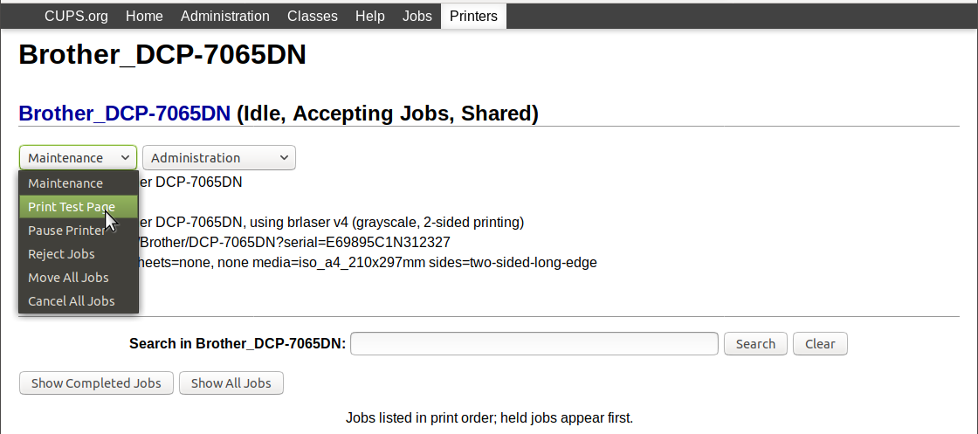
CUPS – Print Test Page

Slide 24
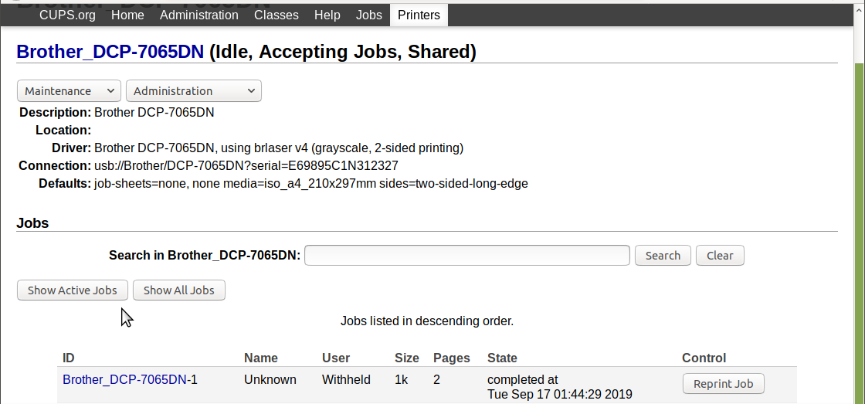
CUPS – Status

Slide 25
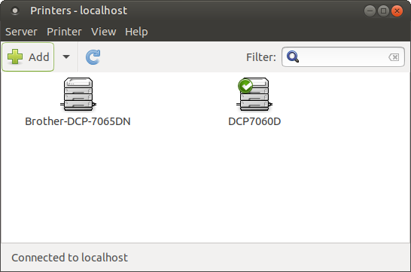
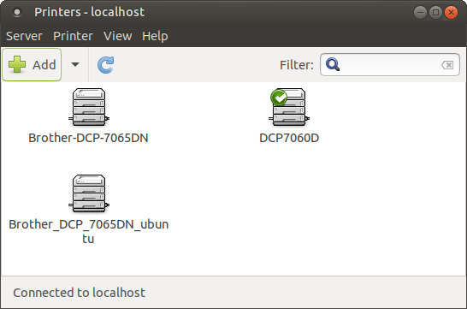
Computers on the Network
Click on System -> Administration -> Printers
The print servers printer will now appear with the print-servers Hostname in its name.
Proceed to print to this print server printer.
print server “ubuntu” printer

Slide 26
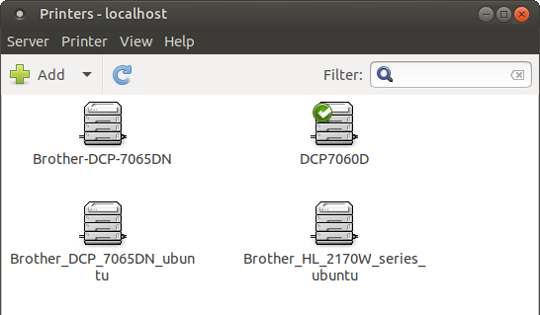
Computers on the Network
print server – Add another “ubuntu” printer

Slide 27
Questions / Discussion

